Slide 1
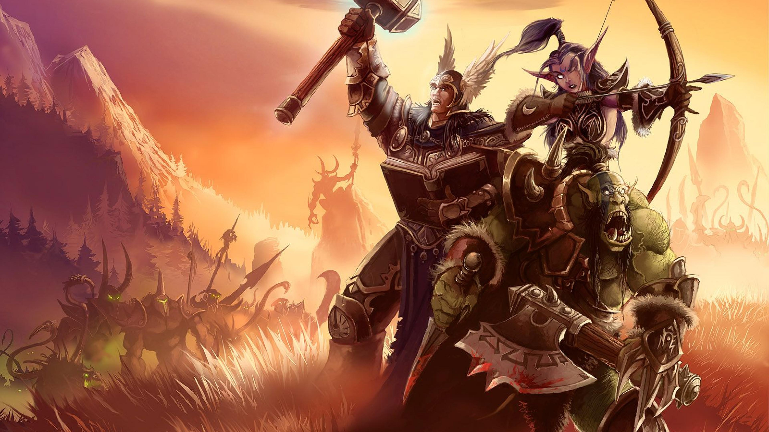
Reverse-Engineering
Noel Danz & Raoul Baron – WS18/19
Extracting Game Assets from Warcraft 1 (MacOS)

Slide 2
Overview
Where we left off
What we have done since then
What we would want to try if we had the time

Slide 3
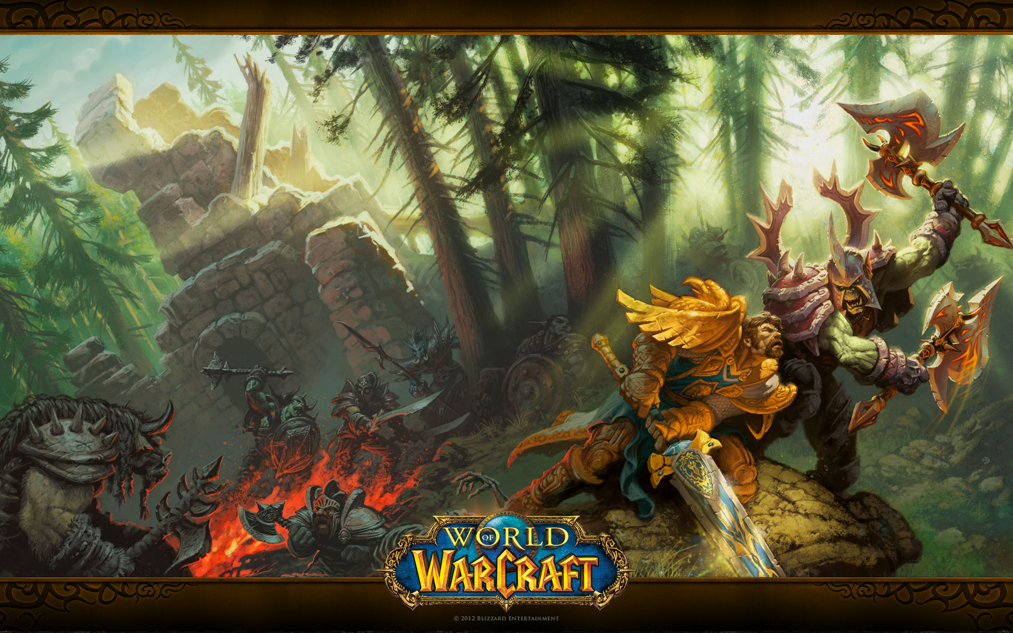
Where we left off
rewritten some extraction tools in Python
extracted text & audio
developed some ideas for helpful tools

Slide 4
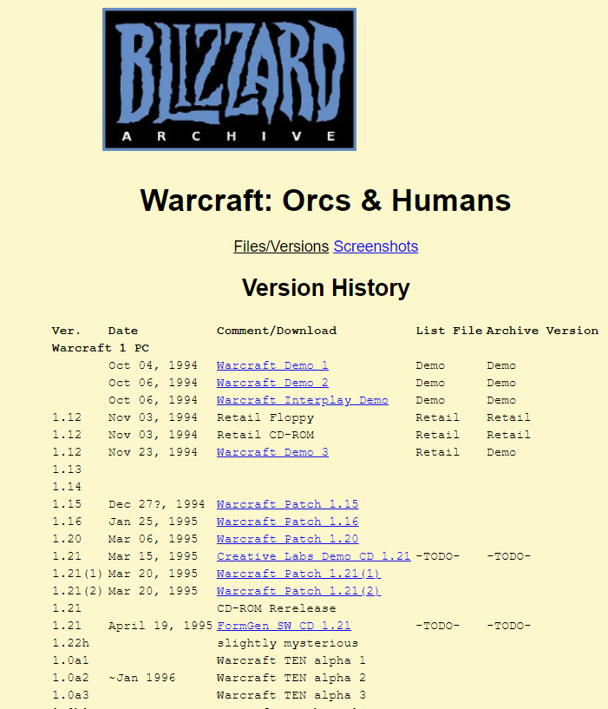
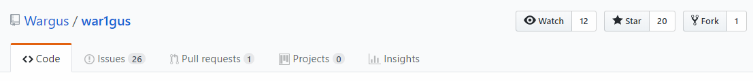
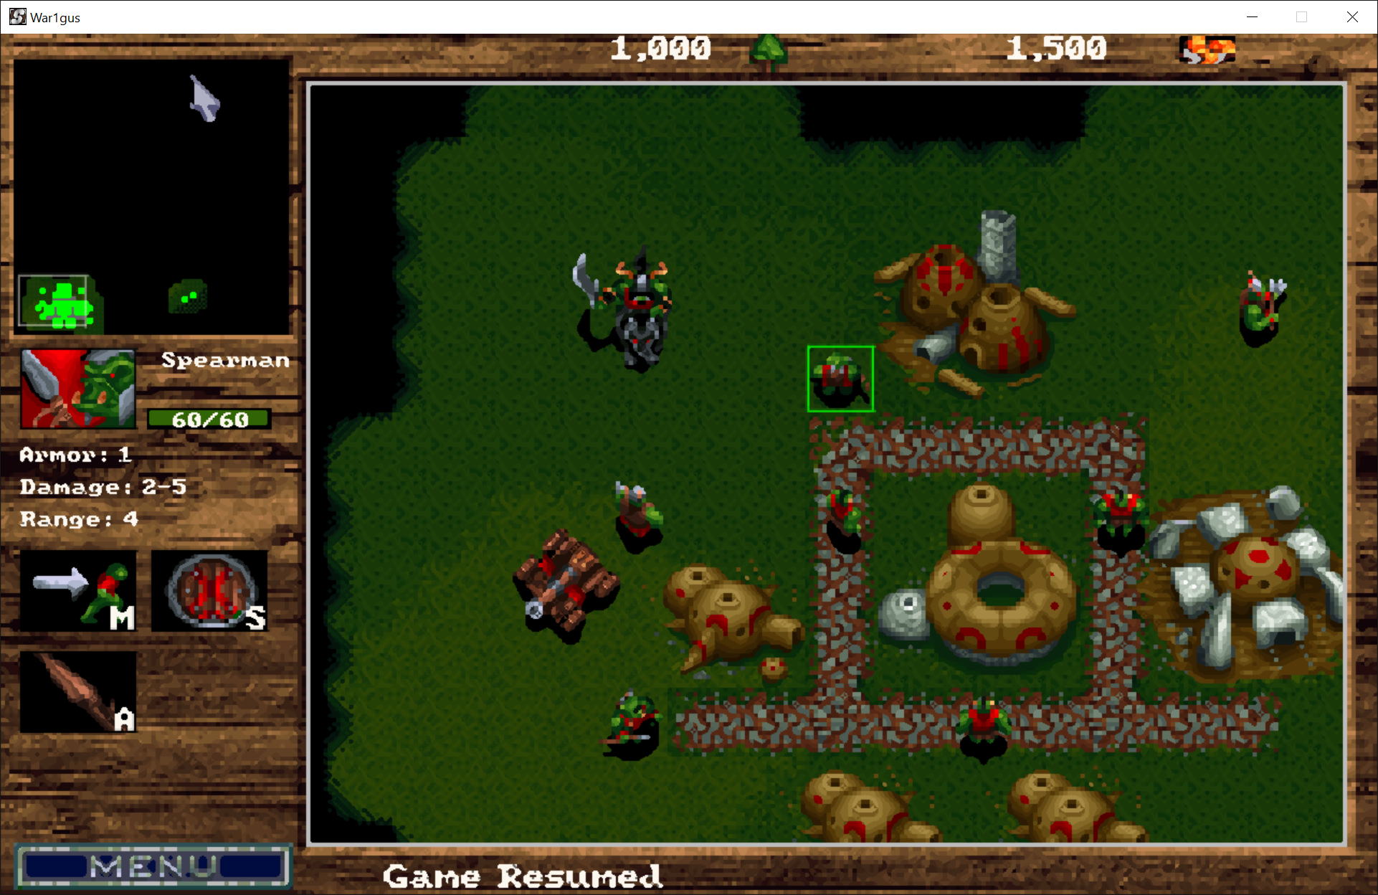
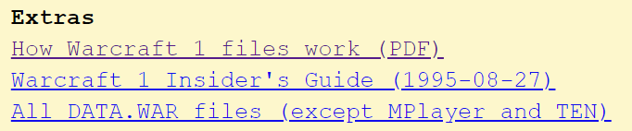
What we had as a starting point
BIN-FILE

Slide 5
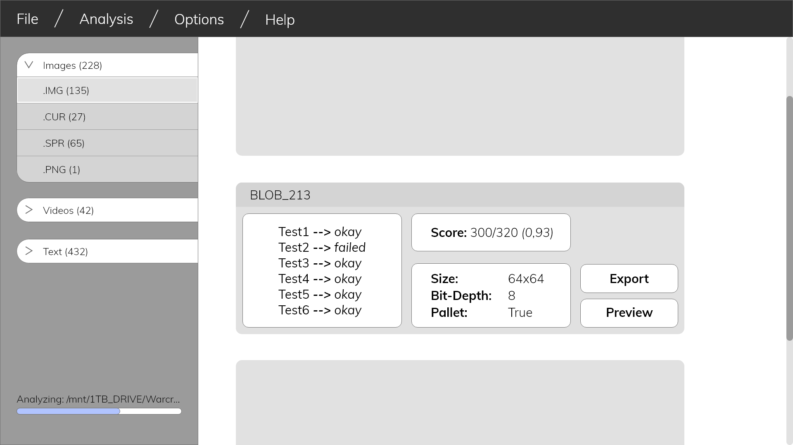
What we wanted to do since we left off
develop the presented tools (for better ease-of-use)
evaluate developed indicators (e.g. For JPEGs)
extract assets from the Binary (as it is the original task)

Slide 6
What we actually did
extracted sprites and image assets
extracted image paletts
endianess is now taken into account
developed a frontend for our tool(s)

Slide 7
What we could not do
developed more & better metrics
time constraints
idea: let the computer discover the metric
neural networks as qualifier
LSTM – networks for analyzing continous data
image metrics
high repetition data
reason about size-bytes

Slide 8
Demo Time
-- frontend --

Slide 9
Demo Time
-- backup --

Slide 10
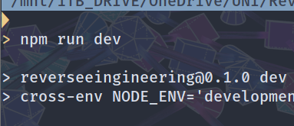
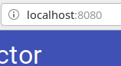
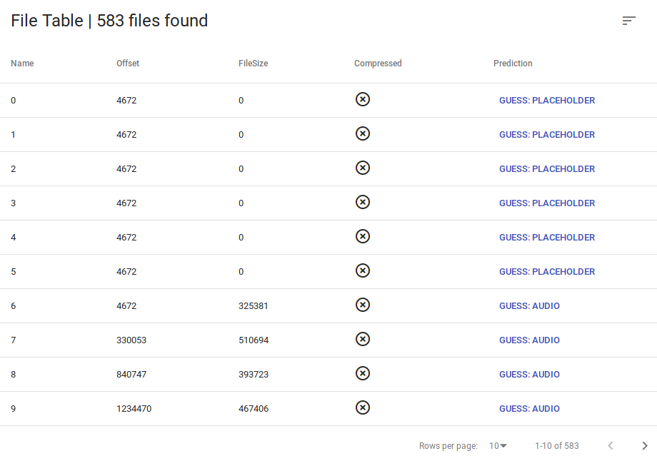
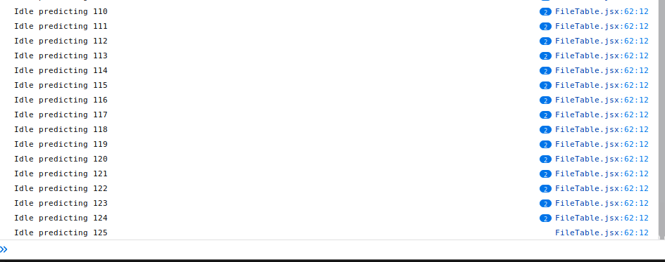
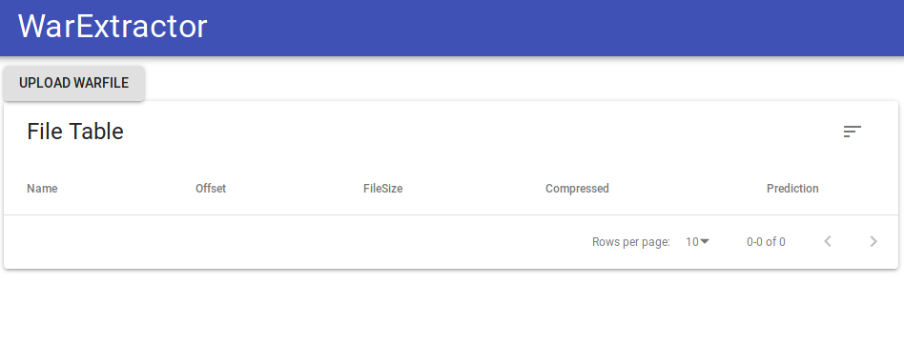

Slide 11
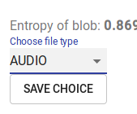
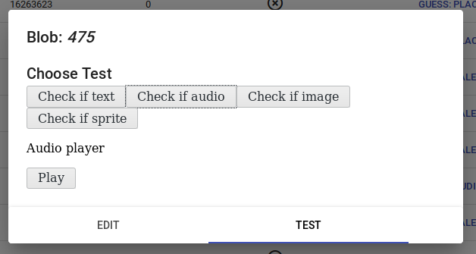
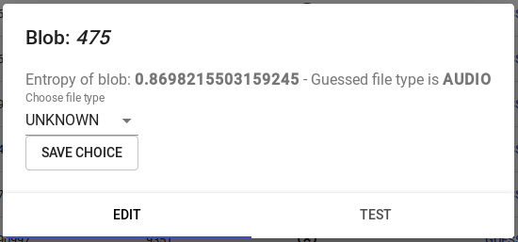

Slide 12
If we had more time we would
try to find more & better metrics
implement the neural network
better UX for the tool
image alignment tool
full circle: hex editor
make it more universal
make it more robust
Thanks!

